Slide 1
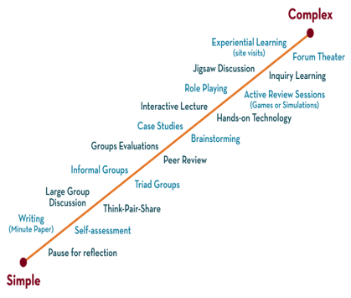
NETWORKS, PROTOCOLS & SECURITY 24EC2210 Topic: Secure Socket Layer
Session-39

Slide 2



AIM OF THE SESSION
To familiarize the students with the basic concept of the socket, Secure Socket Layer, and the working of the simple mail transfer protocol
INSTRUCTIONAL OBJECTIVES
The session is design to understand the:
Introduction of the concepts of socket
To understand the Secure Socket Layer and
To understand the concepts of the working of simple mail transfer protocol.
LEARNING OUTCOMES
At the end of this session, you should be able to:
Describe the concept of Socket.
Describe the Secure Socket Layer and
Describe the working of simple mail transfer protocol.

Slide 3
Syllabus
Preface of Socket ,
Secure Socket Layer

Slide 4
Preface to the Socket
Sockets in computer networks are used for allowing the transmission of information between two processes of the same machines or different machines in the network.
Sockets allow communication of two processes that are running on the same or different machines.
Sockets are the end of two-way communication between two programs that are running on the networks.

Slide 5
Preface to the Socket
Sockets are mostly used in client-server architecture for communication between multiple applications.
The socket is created by the combination of the IP address and port number of the software. With this combination, the process knows the system address and address of the application where data is to be sent.
: is used to separate IP address and port number. or e.g.: 192.168.1.67:80, 155.2.12.23:77, etc.

Slide 6
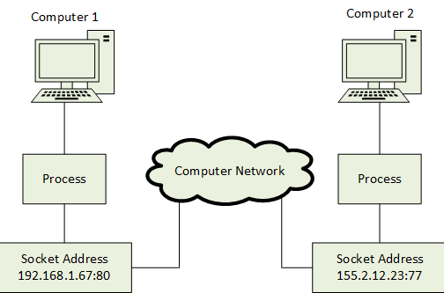
Preface to the Socket

Slide 7
Secure Socket Layer (SSL)
Two protocols are dominant today for providing security at the transport layer: the Secure Sockets Layer (SSL) Protocol and the Transport Layer Security (TLS) Protocol. The latter is actually an IETF version of the former.

Slide 8
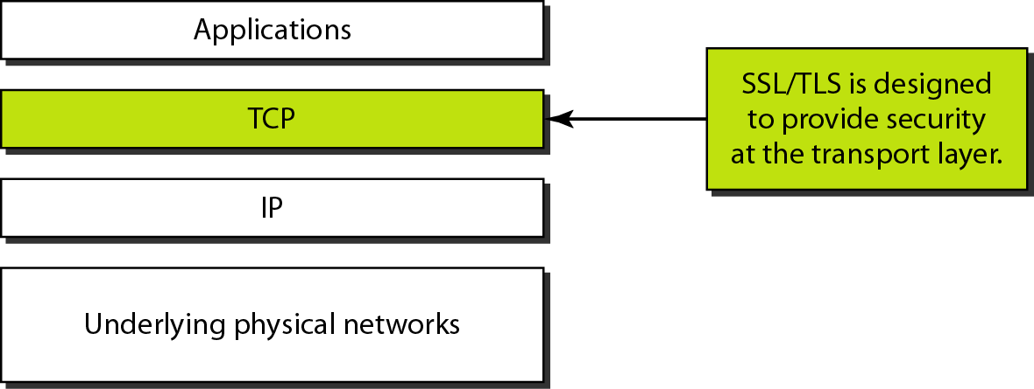
Secure Socket Layer (SSL)
Location of SSL and TSL in the Internet Model

Slide 9
Secure Socket Layer (SSL)
SSL cipher suit list

Slide 10
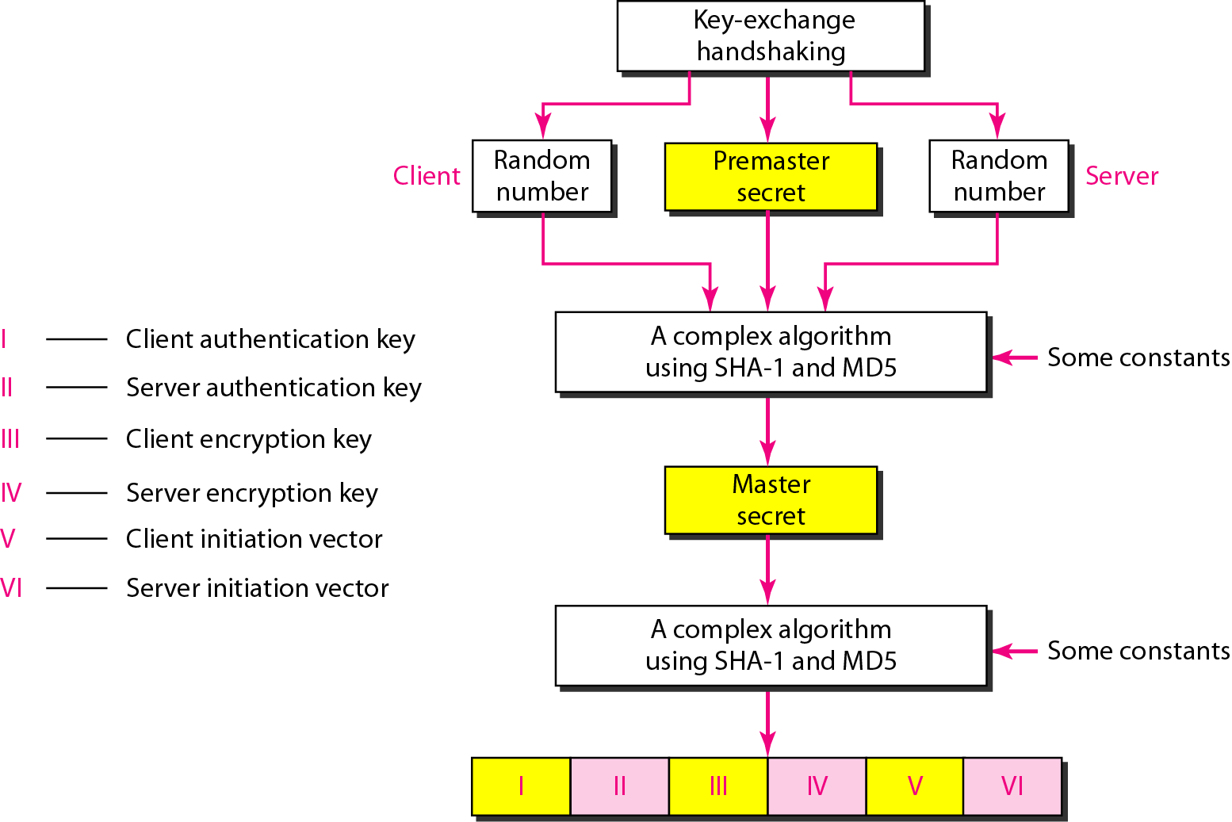
Secure Socket Layer (SSL)
The client and the server have six different cryptography secrets.
Creation of cryptographic secrets in SSL

Slide 11
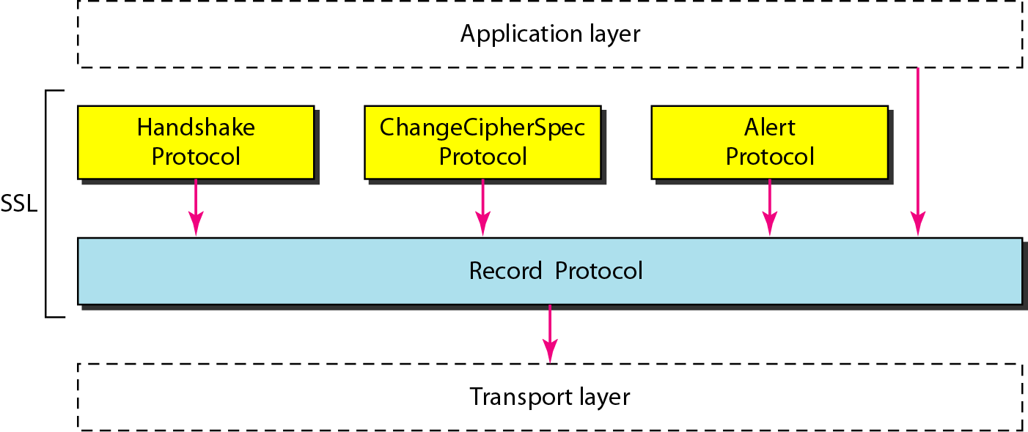
Secure Socket Layer (SSL)
SSL Protocol suit

Slide 12
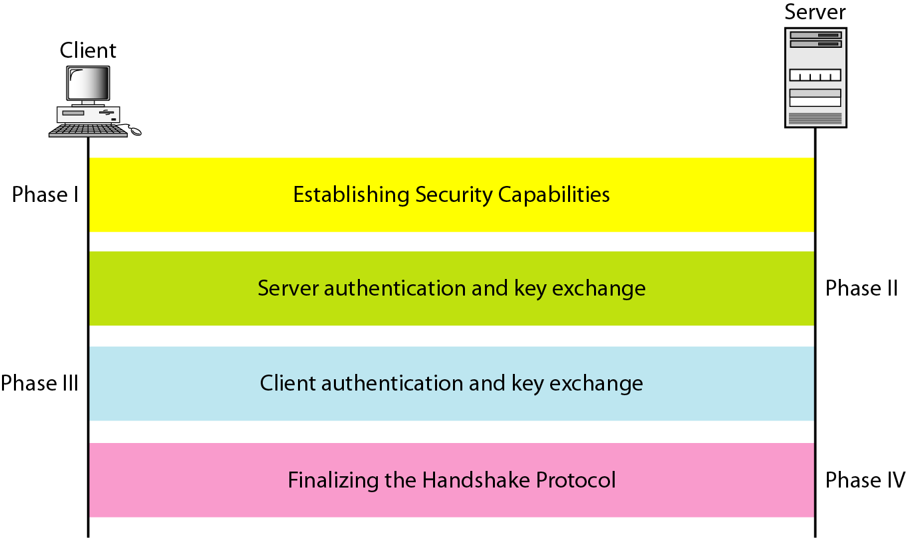
Secure Socket Layer (SSL)
Hand shake Protocol

Slide 13
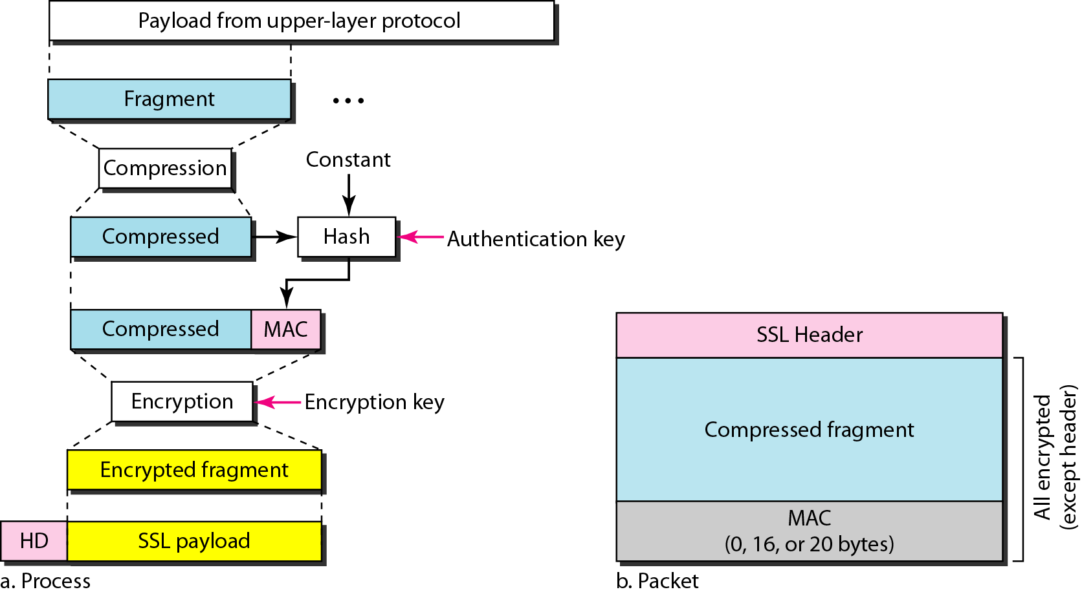
Secure Socket Layer (SSL)
Processing done by the record Protocol

Slide 14
SELF LEARNING QUESTION
In the above figure from left to right, the correct order of the shaded levels are a) Network level, Application level, Transport level b) Application level, Network level, Transport level c) Transport level, Application level, Network level d) Network level, Transport level, Application level
Answer: d Explanation: IP/IPSec is the Network level, SSL or TLS is the Transport Level, Kerberos and S/MIME are the Application level.
In the above figure, which of the above shaded block is transparent to end users and applications? a) IP/IPSec b) SSL c) Kerberos d) S/MIME
Answer: a Explanation: IP/IPSec is the Network layer which is transparent to end users and applications.

Slide 15
REFERENCES FOR FURTHER LEARNING OF THE SESSION
Reference Books:
Data Communications and Networking (3rd Ed.) “–B. A. Ferouzan – TMH
Computer Networks (4th Ed.)”, A. S. Tanenbaum – – Pearson Education/PHI
Sites and Web links:
https://www.scaler.com/topics/computer-network/socket-programming/
https://www.geeksforgeeks.org/socket-in-computer-network/
https://www.cloudflare.com/learning/ssl/what-is-ssl/
https://www.geeksforgeeks.org/secure-socket-layer-ssl/
https://www.javatpoint.com/simple-network-management-protocol
https://www.manageengine.com/network-monitoring/what-is-snmp.html

Slide 16

THANK YOU
Team –NETWORK PROTOCOLS & SECURITY (NPS)

